Slide 1
Platform Engineering
Enabling secure developer self service

Slide 2

A few topics…
Understand pain points, goals and objectives
Share learnings & some of Microsoft’s journey
Enabling “self-service with guardrails”
Notes:
Speaker Notes:
Today we’re going to explore the rapidly evolving world of platform engineering, a space where we see opportunity emerging for just about any organization. To that end, we’ll cover a few topics. First, we’ll talk though the pain points we’re hearing from customers and map out the goals and objectives behind platform engineering. Next, we’ll share our journey towards platform engineering internally and some of the learnings we’ve had along the way. Then, we’ll take a look at some demos and talk about how you can start implementing self-service with guardrails out of the box today, with exciting new tools like GitHub Copilot. Finally, because this is an evolving area, we want to hear from you. At the end, we’ll set aside some time to hear you what you think about our vision for platform engineering and the direction we’re taking to get there. <click>

Slide 3
DevOps practices are maturing…
Challenges
Some of the jobs to be done…
Central teams need to support…
Standardization: frameworks, opinionated stacks, …
Discovery, e.g. catalog for apps, infra, docs
Common approaches & solution templates
Isolation (projects, workloads)
User management/RBAC
UX – CLI / UX
Tool flexibility/addons
App deployment
Policies (infra, build, deployment, …)
Observability
Cost / Quotas
Maintenance
Variable app stacks, infra, software
Complex integrations across diverse stacks
The same “agile” pace of multiple dev teams
Dev teams need to manually understand, maintain compliance, and other recommendations
Tribal knowledge and organizational amnesia
Result
Inconsistent standardization and compliance
Potential for sub-optimal designs, lack of reuse
Increased cost, risk
Manual process reduces developer velocity and time to business value
Notes:
Speaker Notes: This story starts with the current state of development. How are our DevOps practices maturing over time?
While the benefits of DevOps are very real, we are seeing emerging challenges that limit productivity and developer satisfaction. At the heart of these are the challenges faced by central teams that are responsible for the technology used by all development teams, which have different needs and different agile paces, leading to increasingly complex tech stacks. This creates challenges in accelerating time to market, as in addition to the diverse challenges every development team faces due to their unique stack, compliance must be solved and resolved for every new project by hand. As a result, “tribal knowledge” emerges from team to team, which can create information gaps that hard to fill when people leave and make it difficult to onboard new team members. Fixing these problems isn’t simple. There’s a very long list of jobs that have to be done, just to get the basics in place.
<click>

Slide 4







Just starting projects is challenging
Cloud operations team has strict requirements for applications. Read this documentation. We’ll need to do an audit before you can set up your dev environment.
Read this document on our common app foundations and shared app services. BTW – We’re introducing more in a few weeks.
Cloud Ops
Our DevOps team is pretty booked. We can get you setup with a standard pipeline, but we will need to book a meeting to discuss your requirements.
Architecture
DevOps
We have weekly security office hours. We can discuss your needs there.
Security
Other roles
?
?
?
Uh oh. Our management asked us to start
by the end of this week. What now?
How can we keep all this up to date as things change?
I just want to code.
Dev Lead
Notes:
Speaker Notes:
Many of these problems become clear when trying to do what should be a simple task: just starting a new project and getting team members onboarded.
Today, onboarding team members can be a convoluted process that requires coordination across a variety of teams. For dev leads, this means taking the time to read through long, complex documentation—that’s constantly being updated with new guidance and requirements. Dev leads may need to meet with security teams to align on necessary roles and permissions, validate their cloud infrastructure with cloud ops teams, and meet with DevOps teams to set up the project and align on any special requirements it may have.
This process can quickly spiral from days to weeks, putting dev leads between a rock and a hard place when management expects fast start times—and their developers just want to code, not jump through administrative hurdles. <click>

Slide 5
A bit about Microsoft’s journey…
One Engineering System
Notes:
Speaker notes: So, how do you go about solving the problem. What are the lessons we’ve learned? To answer those questions, we’re going to take a look at Microsoft’s platform engineering journey.

Slide 6
Provide a standardized, secure, and scalable foundation for software development teams
Microsoft’s Platform Engineering Journey
Notes:
Speaker notes: At its core, that’s meant working to provide a standardized, secure and scalable foundation for software development teams.

Slide 7

The mission of 1ES
One Engineering System is to empower every Microsoft developer ​​​​​​​and their team to achieve more.
“
There cannot be a more important thing for an engineer, for a product team, than to work on the systems that drive productivity. So, I would, any day of the week, trade off features for our own productivity.
— Satya Nadella, Microsoft CEO
”
Notes:
Speaker notes:
We approached platform engineering through 1ES—or, one engineering system—which had a goal of developing the DevOps standards necessary for building software at scale in Microsoft
Our mission for the One Engineering System: Provide our developers with world-class tools and systems that help them ship products customers love.
Products and services we’re building to help developers build productively, collaborate globally and securely, and scale innovation.
Our goal is to focus on the principles of high-performing teams and enable Microsoft engineering to be high-performing
1ES is three things:​
A mission​
An engineering team building internal tools​
A set of shared objectives:​
Community across the company​
Promote reuse of tools and services both internally, and where it makes sense, externally​
Integrate compliance standards into the workflows​
Though this process, we’ve been moving from a culture of single ownership to one of collaboration and shared ownership

Slide 8
The three traits of One Engineering System
Community across the company to help drive tooling, culture, and process learnings
Integrated and connected services promote reuse both internally and externally
Privacy, security, and accessibility standards are built into our workflow
Notes:
Speaker notes:
As 1ES evolved, the following three traits emerged as critical to the process.
First, community across the company was vital to help drive tooling, culture and process learnings. Second, services needed to be integrated and connected to promote internal and external reuse Third, to achieve the best adoption rates, privacy, security, and accessibility standards needed to be built into our workflows. <click>

Slide 9


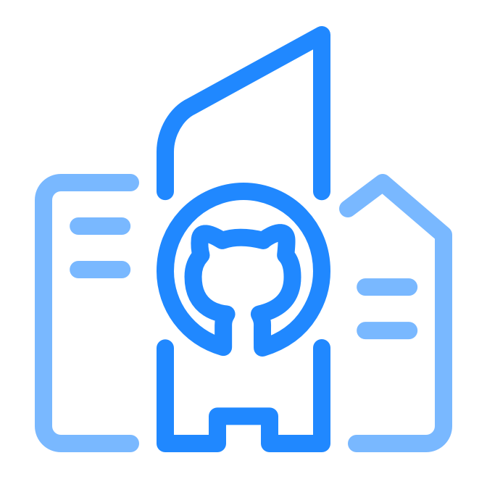
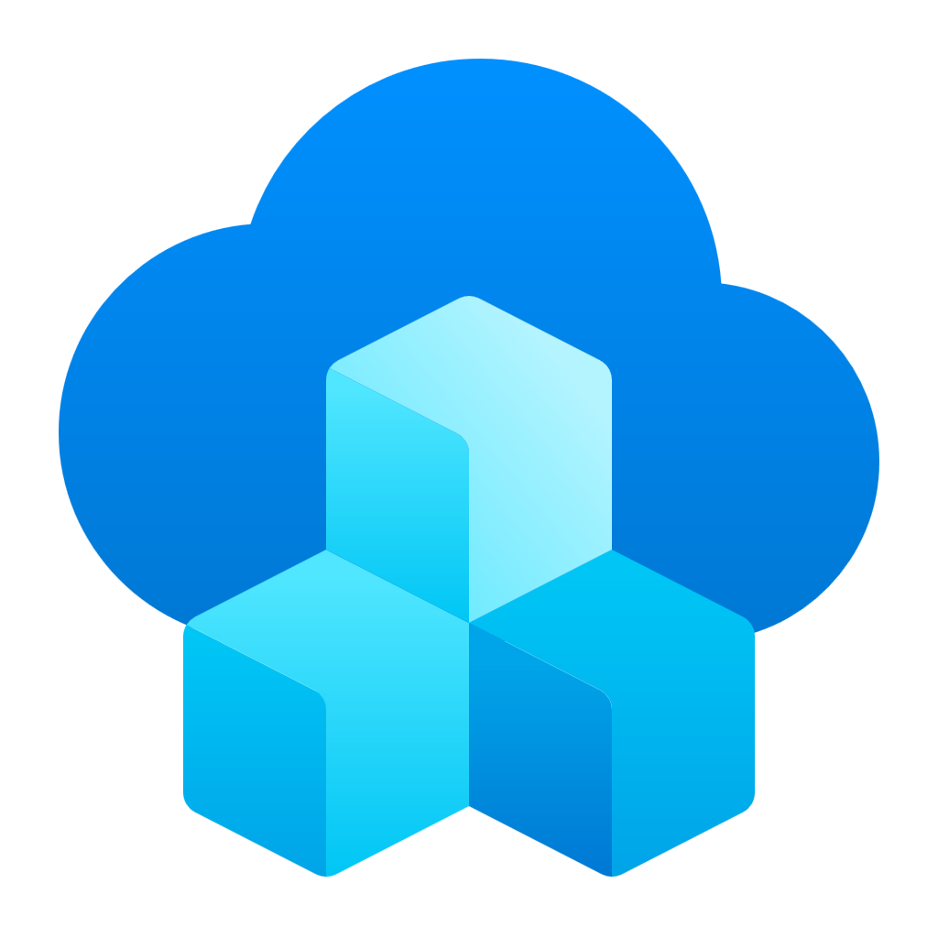


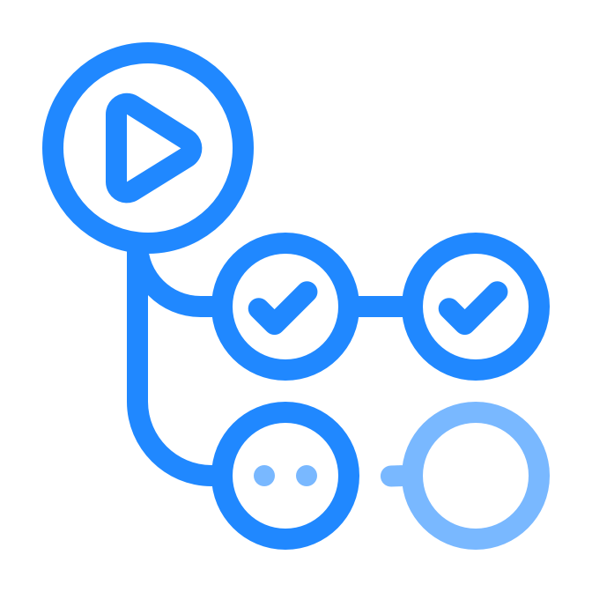

Microsoft’s internal engineering platform
Integrated developer experiences that improve productivity & satisfaction
Performance and security
@enterprise scale
App Developers
Local customizations
and Extensibility
Engineering Platform
Security, Platform Management and Integrated Experiences
Retail Microsoft Developer Products
Notes:
Speaker notes: At Microsoft, we’re in a unique position where we’re developing the tools that we use for development. This has enabled us to create a very tight feedback loop, making it easier to identify problems in our internal engineering and directly fix them in a timely manner. That’s enabled us to quickly learn vital lessons about platform engineering, supporting performance and security at enterprise scale and to create integrated experiences that improve developer productivity and satisfaction, on our own products and open-source products as well. <click>

Slide 10




Focus areas
Speed & Innovation
Talent & Happiness
Developer
Time to Value
Trust & Quality
Collaboration & Scale
Notes:
Speaker notes:
As part of that process, we changed how we collaborate, develop, and deliver by examining ...
...speed and innovation
...developer talent and happiness
...the trust and quality of our products
...and internal (InnerSource) and external (open source) collaboration and scale
Empowering teams to achieve more means accelerating developer velocity
...enabling them to create more, innovate more, solve more problems
Latency is one of the most underrated sources of user frustration
...and Accelerating developer velocity means equipping developers with the tools and services that allow them to be most agile and productive and take advantage of modern development practices.
This includes allowing them to build productively, collaborate globally and securely, and scale innovation.
<click>

Slide 11


KPIs
DORA metrics
NSAT¹
Code velocity
Critical dev workflow times
Developer
Time to Value
MTTR
Open Source & InnerSource
For incidents, security and compliance bugs
Contributions and manual steps for workflows
¹ NSAT = Net satisfaction score ² MTTR = Mean-time-to-remediate
Notes:
Speaker notes:
Of course, measuring these different areas was key to understanding our progress and identifying areas where improvement could be made.
Here’s how we specifically measure and monitor our four focus areas for
Speed & innovation: DORA metrics
Talent & happiness: Net Satisfaction (NSAT)
Trust & quality: Mean Time to Remediation (MTTR)
Collaboration & scale: Open source and InnerSource
Another way to think about 1ES’ focus areas and areas critical to DevOps in an organization is...
Ship Fast to Experiment and Learn
Ship Confidently and Securely
Standardize the Toolchain
Grow Teams and Invest in Engineering Systems
<click>

Slide 12
Eliminate unhelpful KPIs
Measure outcomes not, outputs:
Original estimate
Team burndown
Completed hours
Team velocity
Lines of code
# of bugs found
Team capacity
% code coverage

Slide 13




Metrics & KPIs
Customer usage
Pipeline throughput
Live-site health
Employee health
How much value are users getting?
Acquisition
Retention
Engagement
Satisfaction (NPS)
Feature usage
How efficient is the DevOps process?
Time to build
Time to test
Time to deploy
Time to improve
Failed and flakey automation
How quickly can you detect and fix issues?
Time to detect, time to communicate, time to mitigate
Customer impact, customer support metrics
Incident prevention items
Aging live-site problems
SLA per customer
How can you understand how employees are doing?
Monitor for burnout
Administer surveys to gather employee concerns
Track vacation time
Notes:
Speaker notes: When measuring and quantifying outcomes, focus on the most critical and impactful key performance indicators (KPI). For us, the key is to start small, with just a few critical KPIs that you’re confident you can measure. In doing this, consider your pain points—what are the key areas where improvement would have a disproportionately large impact? Those are the places to get started. Over time, as you gain mastery of those, you can move towards more complex KPIs.

Slide 14
The keys to platform engineering

Slide 15
Platform engineering definition
Platform engineering is a practice, built up from DevOps principles, that seeks to improve each development team’s security, compliance, costs, and time-to-business value through improved developer experiences and self-service within a secure, governed framework. It's both product-based mindset shift and a set of tools and systems to support it.
Notes:
Speaker notes:
So, what can organizations do to solve this problem? That’s where platform engineering comes into play. Platform engineering is a practice, built up from DevOps principles, that seeks to improve each development team’s security, compliance, costs, and time-to-business value through improved developer experiences and self-service within a secure, governed framework. Because it’s a practice, it’s not a switch you flip, where you’re suddenly doing “platform engineering.” Instead, it’s the accumulation of best practices developed with that specific goal in mind.
To put it simply, the goal of platform engineering is to provide a standardized, secure and scalable foundation for software development teams. It’s looking to improve your security posture, compliance, costs, and drive business value by focusing on developer experiences and enabling self-service at scale within a secure, governed framework.
Consequently, it requires both a mindset shift across your development organization that focuses on delivering this new “platform engineering product” to your internal teams, as well as a set of tools and systems that can make that shift a reality.

Slide 16
Platform engineering first steps
At each step, establish metrics that are key to your success at that stage.
Use these to distill insights that determine if, and when, to move to the next step.
Establish platform engineering “product team”
Inventory & centralization
Automate ”high toil” areas
Create a dedicated product team, which could be virtual, responsible for working across the organization to create a self-service developer platform.
Perform an inventory of existing tools, engineering systems, and application platforms. Evaluate usage to determine where to invest and candidates for deprecation. Begin centralizing and reducing redundancy.
Identify areas of high developer toil and automate them. These may be areas of “human in the loop” processes, etc.
Blaze paved paths
Deploy environments as a service
Optimize self-service developer experiences
Use templates to create “paved paths” that help developers “fall into the pit of success” by easily following organizational best practices.
Develop guardrails and ensure separation of concerns security, e.g. leverage techniques for “on-behalf-of” infrastructure provisioning to prevent over privileged access.
Create self-service with guardrails that are easy to consume, secure and are compliant by design. Platform is offered as a “product”.
Notes:
Speaker notes:
So, how does platform engineering work in practice? The first thing to understand here is that it’s not a linear, sequential journey. Different organizations are in different places and have different needs, so the path to platform engineering may look very different from place to place, even as the core goals remain the same. The key to success in implementing platform engineering is to determine what your next step is, establish the key metrics for that stage, and work towards that goal, refining along the way, and continually refencing your key metrics to determine if your efforts are succeeding and when the right time to move to the next step is.
Common steps include:
Establishing a platform engineering product team, which will be responsible for creating the infrastructure that enables developers to self-serve critical resources on-demand. Taking inventory of existing tools, to understand what should be invested in, centralized, or deprecated to reduce redundancy. Automating “high toil” areas—or finding ways to automate key steps that create a lot work, but don’t generate a ton of value, for developers. Create templates for resources that have best practices built in can help you blaze paved paths for developers that make their work easier and more compliant without extra steps on their part. By deploying environments as a service, you can separate concerns and apply guardrails to your infrastructure to make it both easier to deploy and easier to manage.
And finally, optimizing self-service developer experiences can help make resources easier to consume in a complaint manner. <click>

Slide 17
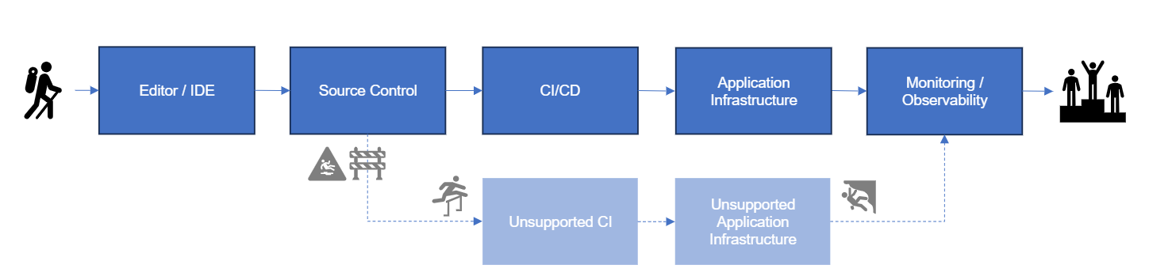
Paved paths
Notes:
Adopt a product mind set Open market adoption

Slide 18
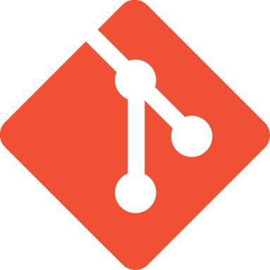





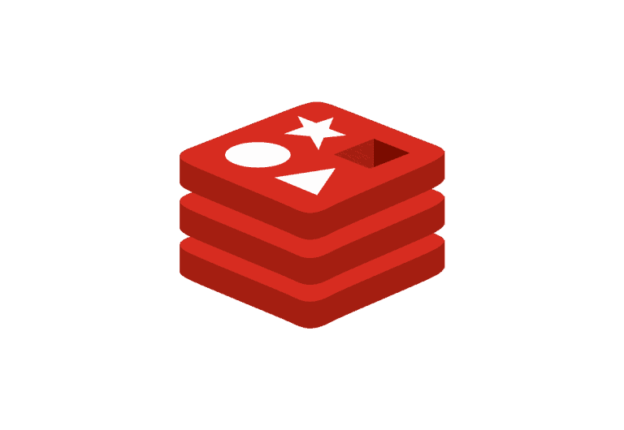



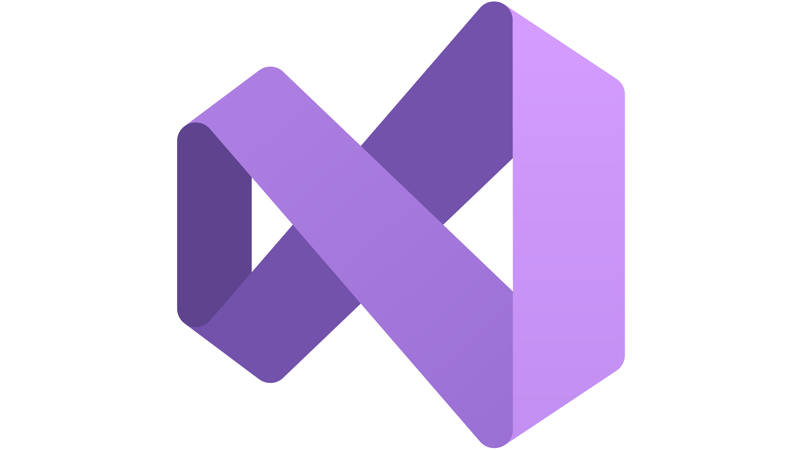

Empowering self-service through platform engineering
1
PE creates a ”paved path” including deployment environments (infra), pipelines, policy, etc.
”Paved Path”
Templates
Pre-configured “Paved Path” Environments (Dev/Test/Prod)
2
PE or dev lead (depending on permissions) provisions shared resources, e.g. K8s cluster
Azure Kubernetes Service
Azure Container Apps
Key Vault
App Front End
Platform Engineer
Cosmos
App Back End
4
The dev deploys to the app infra, leveraging their self-served resources
Redis Cache
3
The dev selects the shared env, and provisions “non-shared” resources, e.g. database, cache
Build
Monitor
Container Registry
Code
Debug
5
Templates are also used in the pre-configured pipelines for app deployment
”Paved Path” Workflows
Developer
GitHub Actions
Test Env
Test Sub
Prod Env
Dev Sub
Prod Sub
Dev Env
git push
Notes:
Speaker notes: Let’s break down what we just watched. On this slide, we can see the steps platform engineers and developers take within a platform engineering-enabled workflow.
It all starts with the platform engineer creating “paved paths” that streamline deployment of environments (and other app infrastructure). These “paved paths” are enabled by templates that define resources, pipelines, policies, and more.
With the “paved path” templates built, platform engineers provision resources that will be shared across the dev team. Platform engineers can also delegate these tasks to dev leads for more advanced teams. In this example, the resource we’re making available to the team is a Kubernetes cluster.
With templates built and team-based resources provisioned, developers can access the shared environment and provision their own personal resources, like databases and a cache
Now, developers can deploy the app infrastructure they need tailor-made developer portal or the CLI in their VDI or code editor. This infrastructure automatically deploys into the pre-provisioned shared resources set up by the platform engineer or dev lead in accordance with the paved-paths established at the start of the process.
These templates can also be deployed automatically as part of an established CI/CD workflow, unlocking eve more opportunities to streamline and automate developer workflows.
<Click>

Slide 19
Implementing platform engineering
Notes:
Speaker notes:
Given these benefits, we’ve started thinking about what’s necessary to get a platform engineering program off the ground. <click>

Slide 20

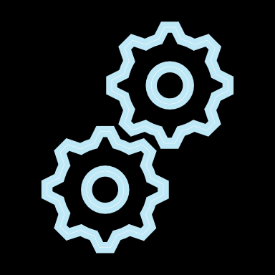



Key aspects of an Engineering Platform
Developer self-service capabilities
Dev identity
Orchestration
& automation
Component &
API catalog
Team
insights
Dev UX
Languages
Source
APIs
Resources
Pipelines
Application
Templates
Web consumer
Web employee
Mobile consumer
Mobile employee
AI/Data Science
Service
IoT
…
Application
Platform
Runtime
Security & Governance
Continuous Improvement
Ops
Compute, Network
& Storage
K8s &
PaaS
Identity
& Secrets
Policies
& RBAC
Compliance
& Auditing
Usage Insights
Observe &
Experiment
Monitoring
& Incident Mgmt
Engineering
System
IC Dev
Collaboration
Continuous Integration & Deployment
IDE / Editor Dev Box
Source Code
Control
Sync & Async Collab
Work Item & Issue Tracking
Build
Security Scanning
Test
CD / GitOps
MICROSOFT CONFIDENTIAL
Notes:
Speaker notes: So far, we’ve covered the practices that go into making platform engineering a success, how might you structure your tech stack to support them? Based on our experience and what we’ve observed customers doing, we’ve found that engineering platforms are composed of three primary parts. First, there is the engineering system, comprised of the developer, collaboration, and CI/CD tools your teams will use daily. Second, there is the application platform, which contains the resources needed for runtime, security and governance, continuous improvement, and operational monitoring capabilities. Third, we have the application templates, which contain resources needed for individual projects. These three elements serve as the foundation for enabling developer self-service to critical resources. <click>

Slide 21
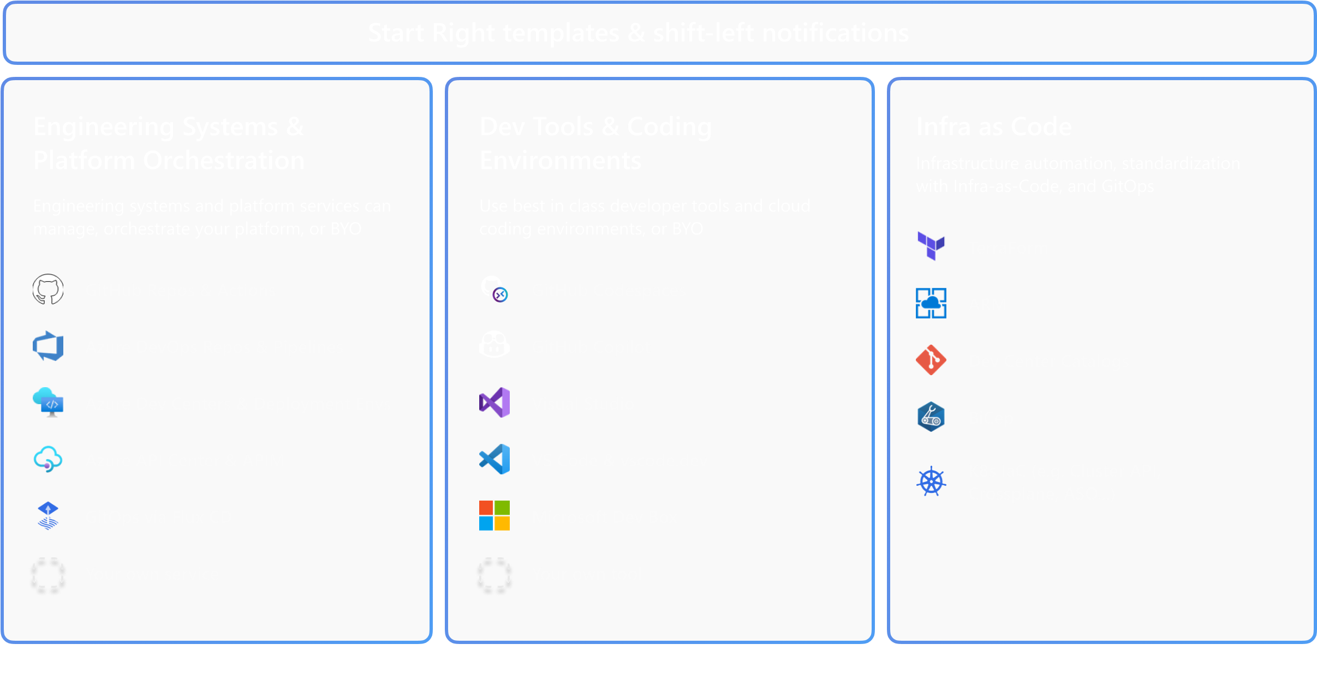
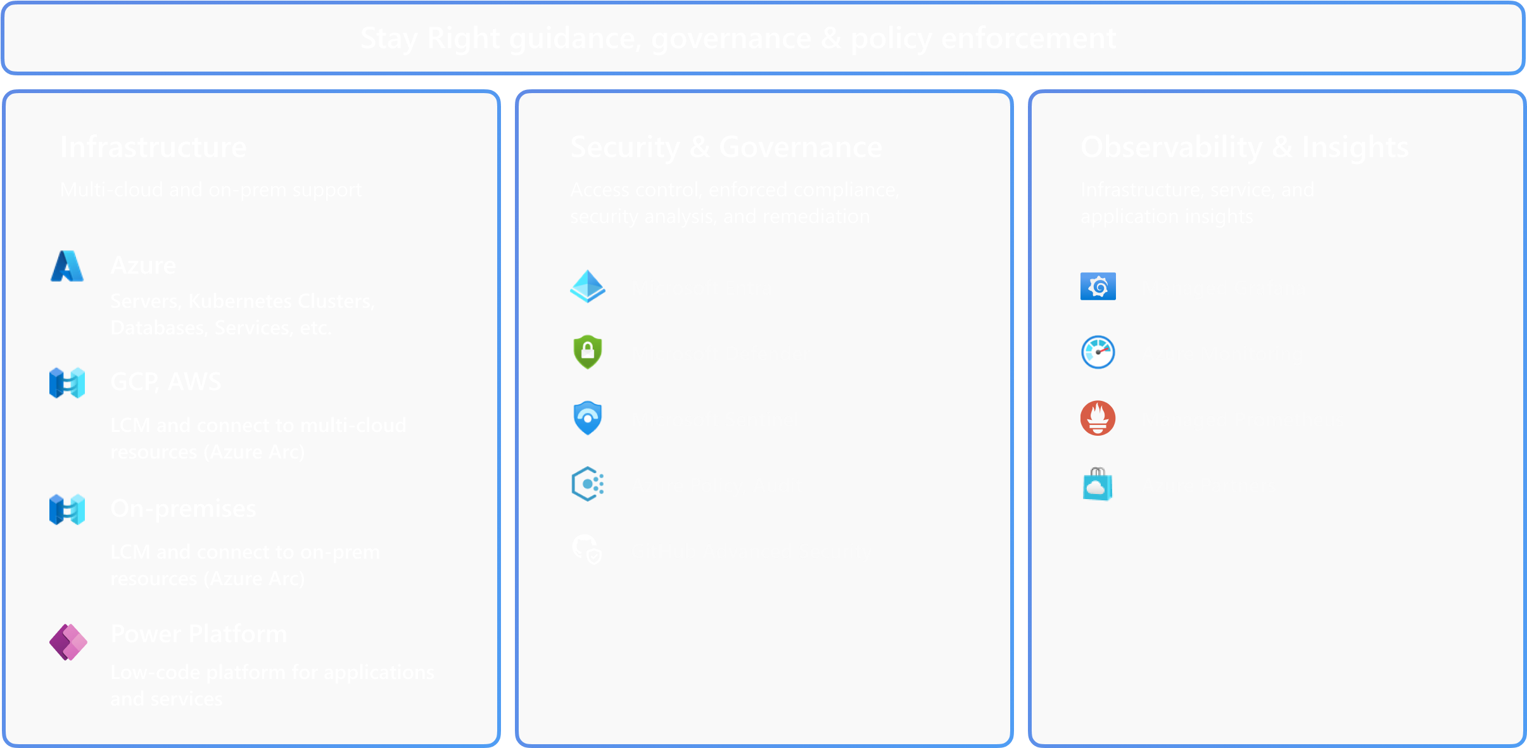
DevOps and Start Right/Stay Right
Deploy &
Code
Operate
Build
Monitor
& Test
& Observe
Continuous
Continuous
Deployment
Feedback
Notes:
Speaker notes:
Of course, that’s all very abstract. Let’s try to make the concept more concrete, and start exploring ways we can make these opportunities real.
In the background, you’ll see the traditional DevOps cycle. As a reminder, platform engineering builds on DevOps—it’s not a replacement for it.
At Microsoft, we tend to break down platform engineering into two major categories that correspond with different parts of the DevOps cycle. First, we have start right templates and shift-left notifications, which are designed to surface information and empower developers to act sooner in the development process through the use of self-service resources. To make that happen, you’ll need engineering systems and platform orchestration, dev tools and coding environments, and support for infrastructure as code. Second, we have stay right guidance, governance, and policy enforcement, which is designed to build organizational governance, compliance, security, and cost control into the DevOps cycle. As a result, things are secure and controlled by default, and your developers won’t feel like they need to circumvent your guardrails to get their jobs done. To make that possible, you’ll need app infrastructure, security and governance tools, and tools for observability and insights.
These are many of the tools that we use as part of our platform engineering journey. As you can see we use a variety of first-party and open-source solutions. Next, we’ll examine a few of these in more detail to understand how they work as part of a larger platform engineering effort. <click>

Slide 22
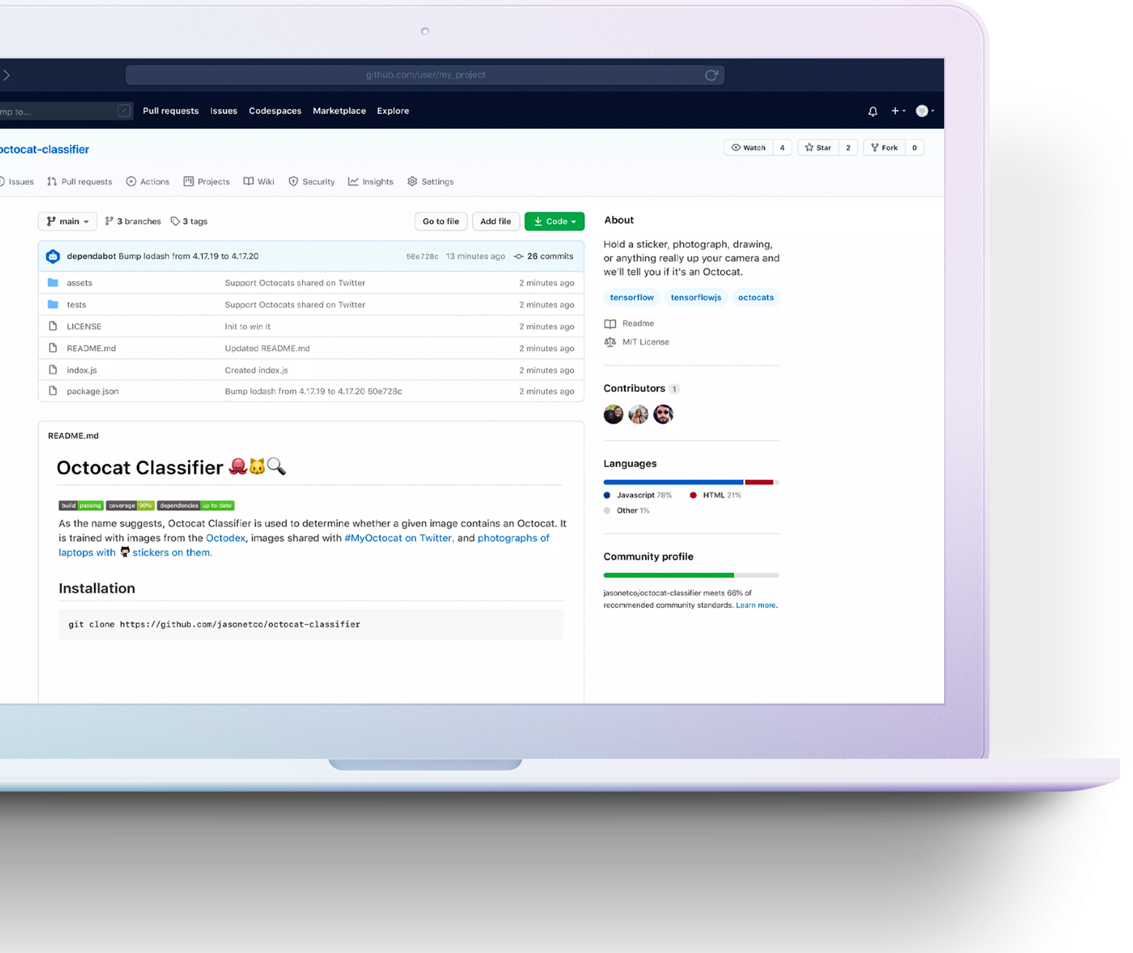
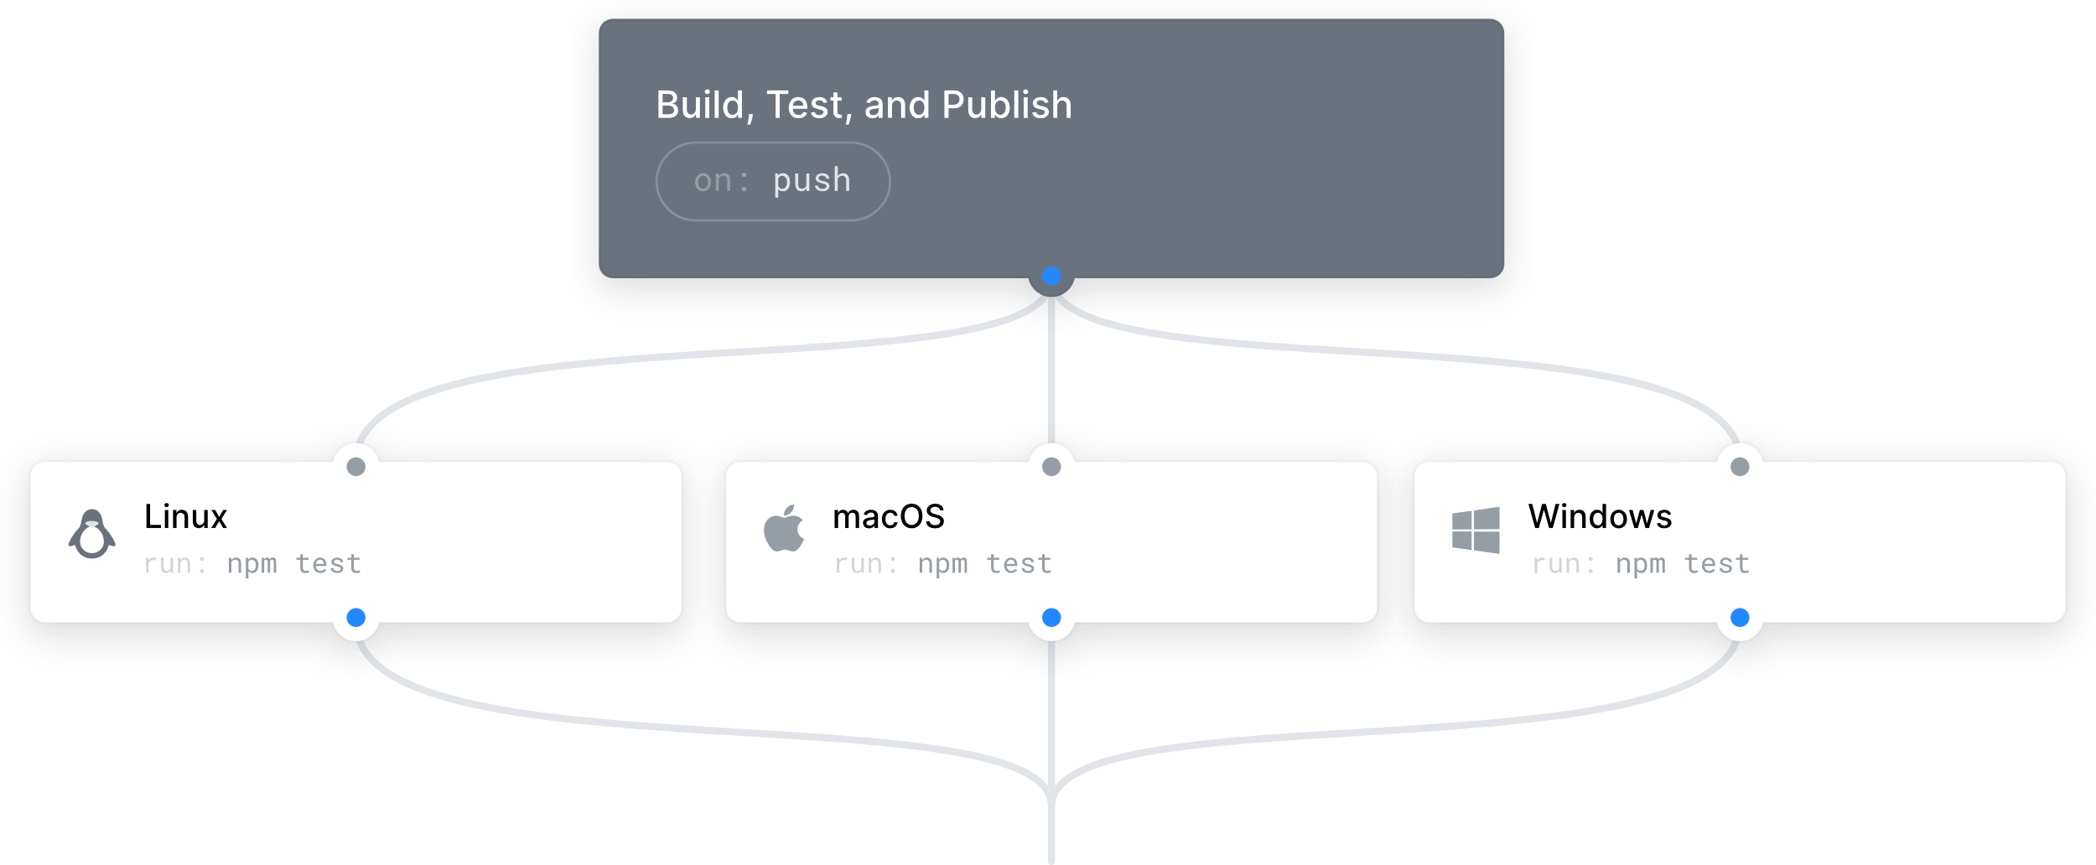


GitHub Repos/GitHub Actions
Start with a foundation for collaboration and automation
Collaborate: GitHub Repositories are more than just code—they help teams collect issues, have discussions, and track changes.
Automate your repository: GitHub Actions enables teams to perform any job, including CI/CD in a customized workflow.
Notes:
Speaker notes:
You’ve probably heard of a GitHub repository. A repository is the most basic element of GitHub, that contains all the code for a project. But, it’s so much more than that, with powerful features for collaboration, like issue tracking, spaces for discussion, and track changes.
With GitHub Actions, we start to see a possible foundation for platform engineering. GitHub Actions enables you to automate any job in your repository, including the CI/CD jobs that are so critical for platform engineering. For example, a pull request could be merged into the main branch of a repo, triggering an Action that creates a new build of a project. Or, when an issue is created, a different Action fires to notify an interested party. As a result, Actions enable you to start multiplying your developers’ actions, as automation can enable one action by a human being to result in one or many different actions being taken automatically—actions the human no longer has to perform manually.
These automations start to add up over time, and as a result, your engineering platform becomes more robust and more powerful. <click>

Slide 23
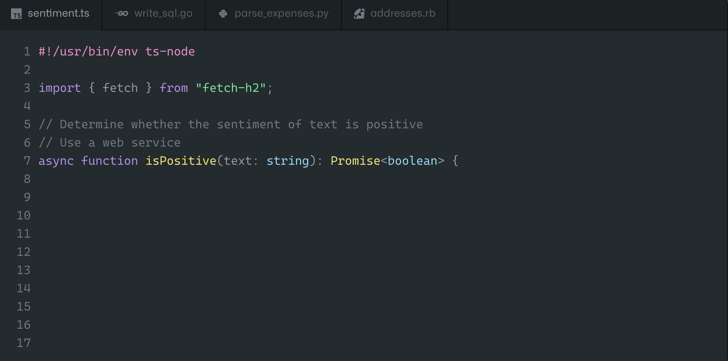
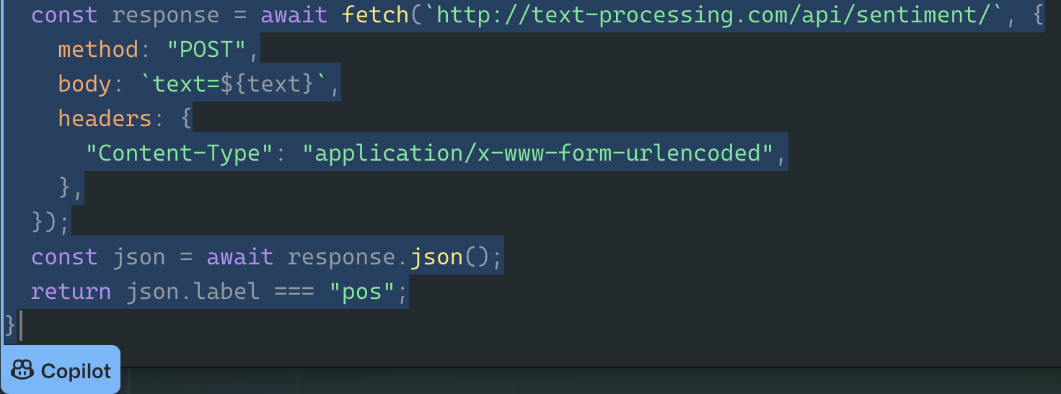
GitHub Codespaces/GitHub Copilot
Provide tools that boost developer productivity
Controlled and Customizable: GitHub Codespaces allows for the instant spin-up of new, secure environments with cloud-native workloads
Accelerate development with AI: GitHub Copilot helps development teams to build and ship software more quickly
Notes:
Speaker notes:
With the foundation for an engineering platform in place, you can start to do some really interesting things with your dev tools and coding environments.
For example, you might start using a tool like GitHub Codespaces, which allows developers to spin up new, secure cloud development environments on demand. These can be done on a per-project basis, reducing the burden of context switching on a single machine, and making it possible to leverage expertise from all over the world, without requiring access to an advanced physical device.
And of course, GitHub Copilot is the most-loved AI developer tool, and it’s proven to help accelerate development. It’s an amazing tool on its own, but where it really starts to shine is when it has access to the full context of code found in a repo. With that context, it can answer more complex questions more specifically. Traditionally, if a developer didn’t understand code in a repo, they would have to interrupt another developer or even the project lead and ask questions.
With Copilot, that same developer can get an answer much more quickly, and independently, raising the efficiency of the entire team.
<click>

Slide 24
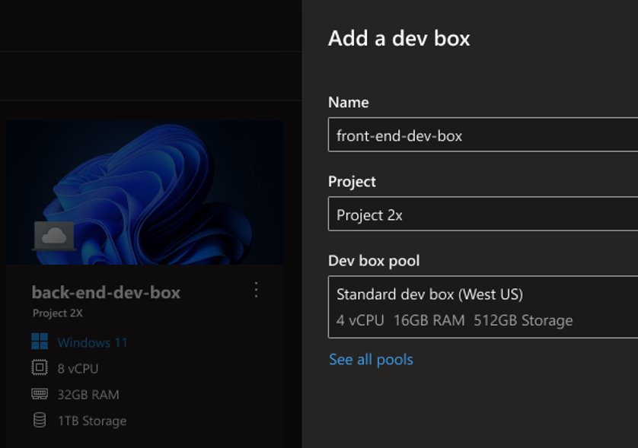
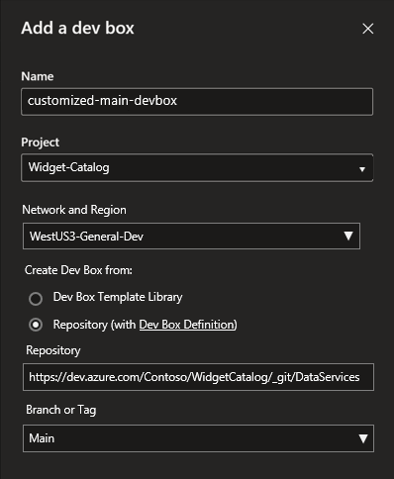
Microsoft Dev Box
Customize and automate developer workstations
Ready-to-code: Self-service, on-demand access to task-specific workstations with scalable compute, available instantly.
Project-based: Preconfigured workstations built by dev teams with the right tools and resources for their projects.
Managed and secure: Centralized governance enables zero trust while maximizing security, compliance, and cost controls.
Notes:
Speaker notes:
So, maybe you like Codespaces, but you want your developers to have more than a coding environment—you want them to have a full workstation in the cloud.
Dev Box meets this need, and transforms the full developer experience by providing devs with development environments that are ready-to-code, project-based, and managed and secured. So what does this mean?
When we say ready-to-code, we mean it helps maximize dev productivity with ready-to-code, self-service workstations preconfigured for specific projects and tasks. Access to the tools and resources developers need can be preconfigured for a Dev Box, alongside however much compute power they need for their current tasks. That means that they can spin one up for a new project and start working in minutes—not hours or days.
Dev boxes are project-based,. This means dev leads can customize workstations with everything developers need for their current projects while adhering to organizational standards. For example, they can include their repo, so that Devs can log into a Dev Box and start working without having to wait on the team’s latest changes to sync. And a Dev Box can be preconfigured with all necessary packages, so that Developers don’t have to run down the packages themselves, and troubleshoot the inevitable configuration errors that result from that.
And because Dev Box is managed and secure, you can centralize governance of workstations running anywhere to maintain greater security, compliance, and cost efficiency. Because the rules are built-in, they’re far easier to enforce, and developers won’t constantly be bumping up against them as part of their daily work.
<click>

Slide 25
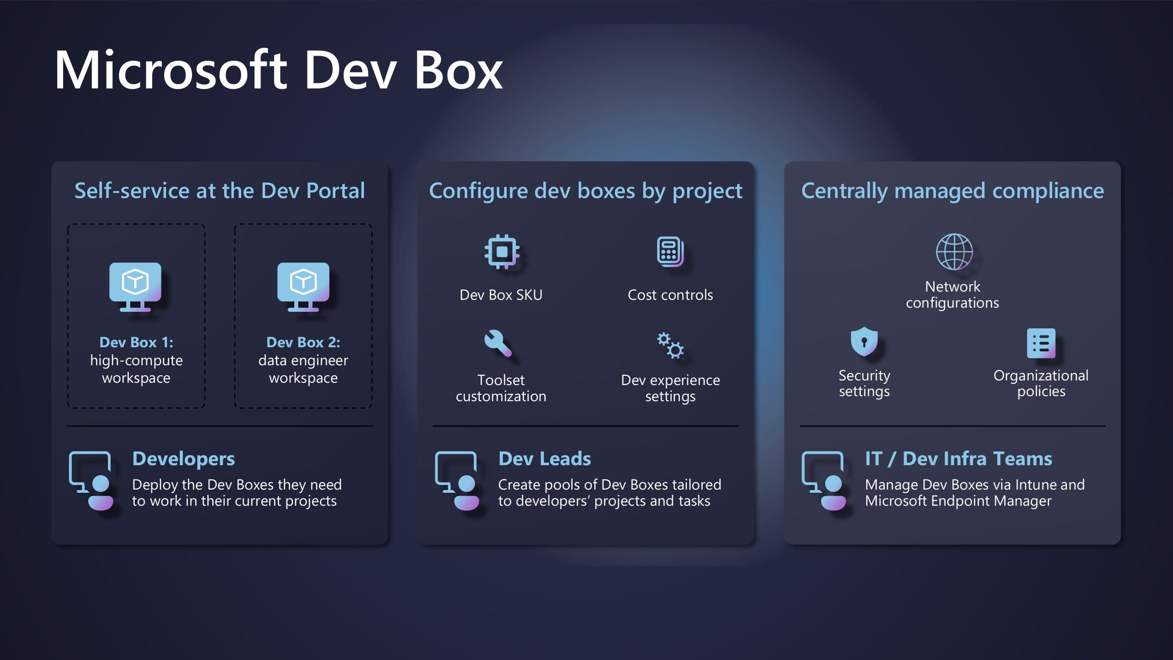

Slide 26
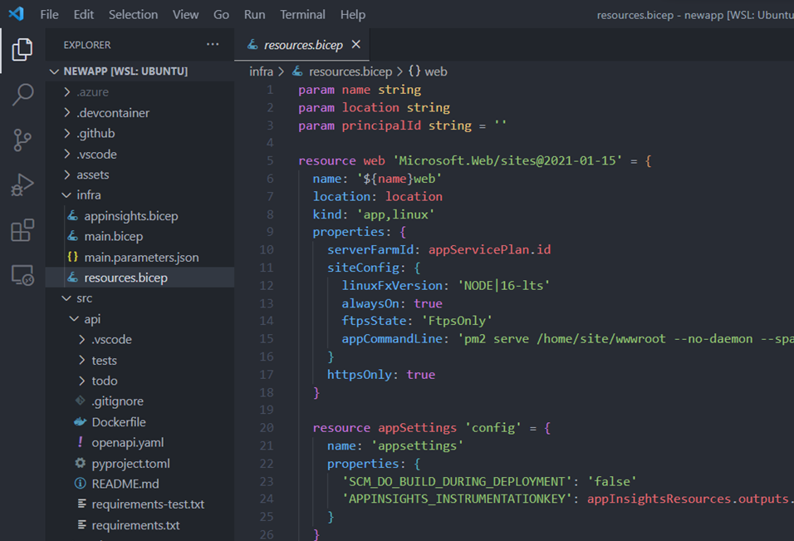
Application templates
Standardize and streamline project management
Repo included: Enable developers to start working on project code immediately
Incorporate governance: Include security, compliance, governance, and cost controls in the template
Support IaC testing: Allow developers to deploy needed infrastructure in an automated and controlled manner
Notes:
Speaker notes:
We just discussed a ton of interesting things you can do with Dev Box. However, if project leads had to manually create each version of a Dev Box for their teams by hand, it would be a slow, cumbersome process, that would be hard to troubleshoot. Application templates provide a way for team leads to customize Dev Box configurations using code. They can attach the project’s repo, so that the code is available when developers launch their Dev Box. They can incorporate security, compliance, governance, and cost controls in their templates. For example, on a smaller, simpler project, they may restrict the size of the Dev Boxes, utilizing fewer CPUs and memory. For a larger, more complicated project, more might be necessary, and again, an appropriate size could be set through the template. This also goes for security and compliance policy. And because testing is a core part of the process, app templates include IaC capabilities to deploy the right infrastructure for testing in a fast, yet secure and controlled manner. <click>

Slide 27
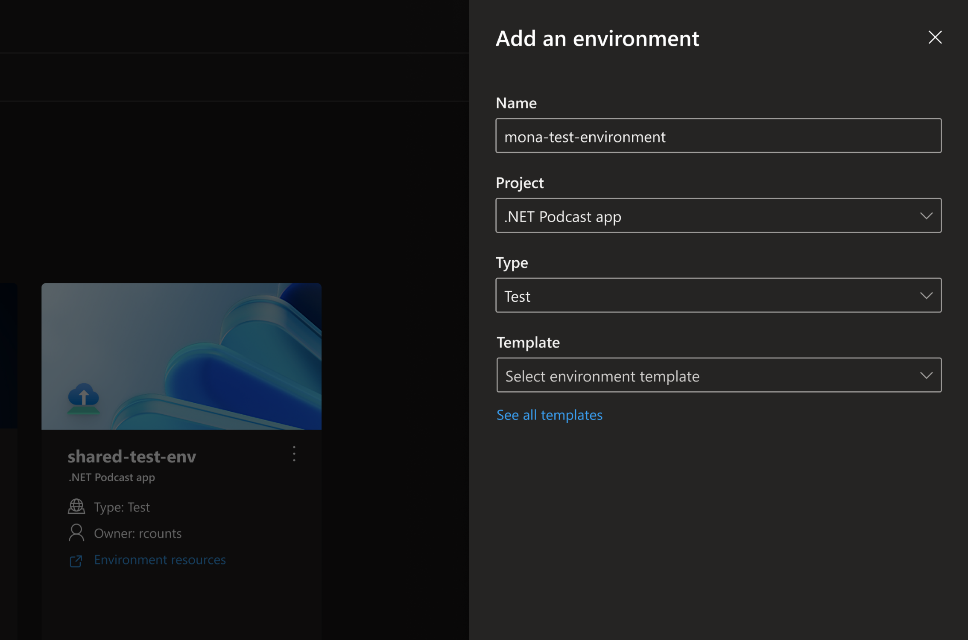



Azure Deployment Environments
Optimize workflows using standardized environments, templates, policies, and tools.
Minimize configuration effort
Secure with confidence
Standardize through templates
Notes:
Speaker notes:
Then with Azure Deployment Environments you can promote collaboration and consistency while minimizing setup time with project-based and standards-based templates that help establish best practices across any project, while being fully managed on the secure, compliant, and globally available Azure cloud.
With efficiency being a key term and goal, ADE can help achieve this and reduce cycle times while accelerating delivery. Quickly spin up app infrastructure with project-based templates that establish consistency and best practices while maximizing security, compliance, and cost efficiency.
ADE and its infrastructure solutions can help bridge the gap between dev and infra teams. It will help organizations to:
Minimize configuration effort by providing self-service, project-based templates that define app infrastructure and deploy directly from where developers work.
Secure with confidence with maximized security that gives centralized permissions and policy governance, access controls, and full management of cloud resource configurations.
Standardize through templates by promoting collaboration and sharing with reusable templates that establish consistency and best practices across projects.
For developers, speed and usability are critical—ensuring they have convenient, self-service access to the infrastructure they need to focus on building and testing their apps without interruption. At the same time, effectively managing security, compliance, and cost requires centralized controls in the hands of IT admins and dev infrastructure teams. By reducing the time and effort required to set up development environments, developers can focus on what they do best – getting creative. <click>

Slide 28

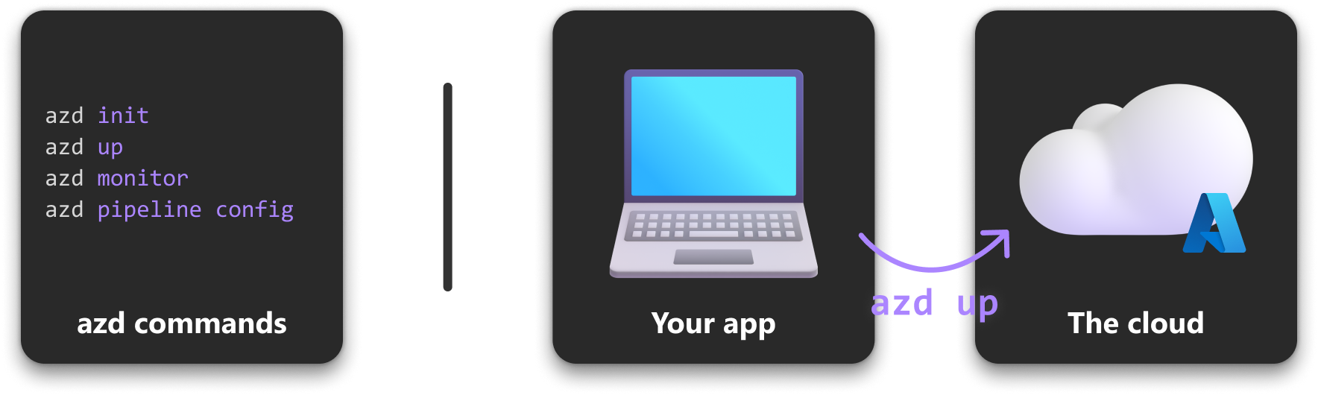

End-to-end developer workflow with the Azure Developer CLI (azd)
From local development environment to the cloud in a single step​
azd up
Notes:
Speaker notes: With the tools we’ve mentioned so far, we’ve really created a foundation for starting right in platform engineering. GitHub Repos and Actions are serving as the base for our engineering systems, Codespaces, Copilot, and Dev Box are providing necessary dev tooling and coding environments, and Azure Deployment Environments and app templates are making it simple for developers to deploy testing infrastructure.
Given the potential complexity of a platform engineering system, we want to make it as easy as possible for developers to do their work. With Azure Developer CLI they can deploy needed resources with just a few commands, right in their terminals, whenever they need them. Without friction between coding and testing, developers will be able to progress more quickly, and focus on catching and fixing bugs rather than getting permission to use and configuring testing resources. So with things like we just covered in place, we start to see the beautiful efficiency of platform engineering come into play. Developers are empowered to do work, while organizational security, compliance, and cost control needs are built into the products devs use, for a much more frictionless experience.
<click>

Slide 29
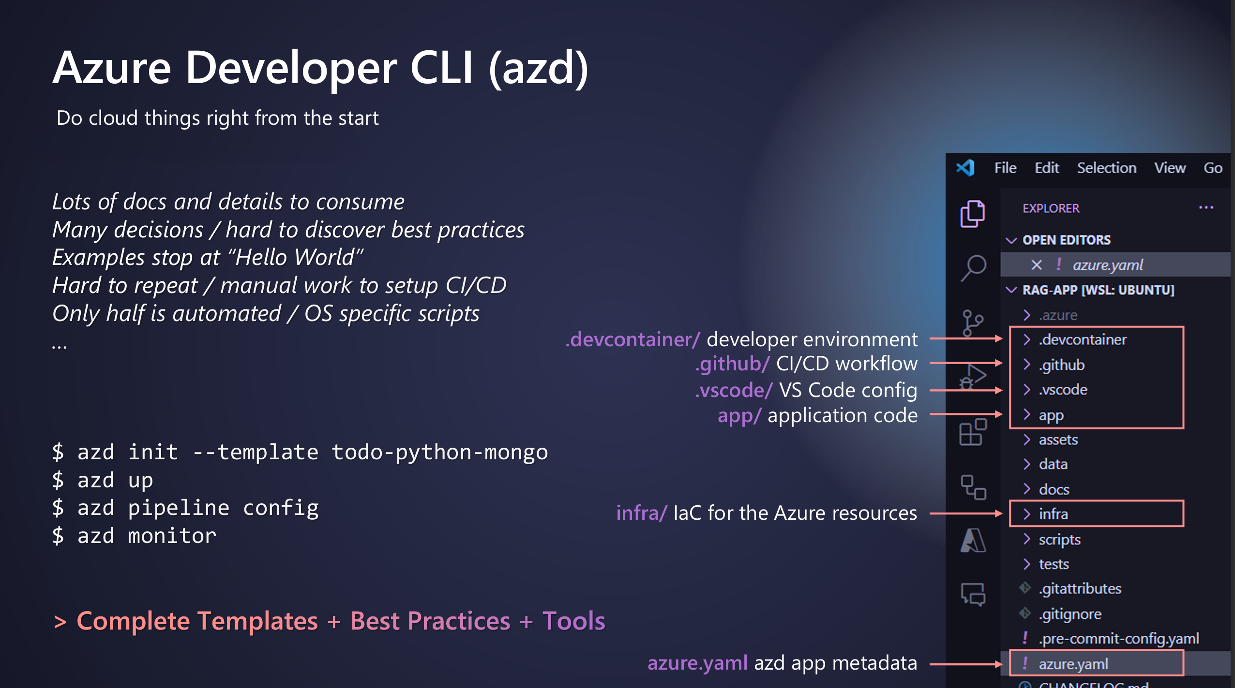

Slide 30
Azure Policy
Apply organizational standards at scale
Create and enforce policies: Enable granular, automated resource control
Programmatic reviews: Revaluate policy compliance when resources are created, changed, or deleted
Remediate non-complaint resources: Automatically remediate detected non-compliant resources
Notes:
Speaker notes:
With so many resources in play, it can be difficult to know if all your policies are being enforced. To really maximize the use of your platform engineering tools, organizations need a way to solve this problem at scale. Azure Policy provides a way to do so. First, it enables organizations to create and enforce resource policies, using an Infrastructure as Code-like syntax. Second, it allows organizations to programmatically rereview resources for compliance during common changes like creation, update, or deletion. Third, if a resource fails its review, organizations can set up policies to automatically remediate the non-compliant resource. This is huge for maintaining security policy and cost controls across an organization. And with that, we’ve come full circle. Platform engineering enables developer self-service, but unconstrained self-service would be a disaster! With the right tools for infrastructure and policy management in place, platform engineering not only discourages non-compliance, but actively builds organizational guardrails into products and services, making them a seamless part of the development process.
<click>

Slide 31
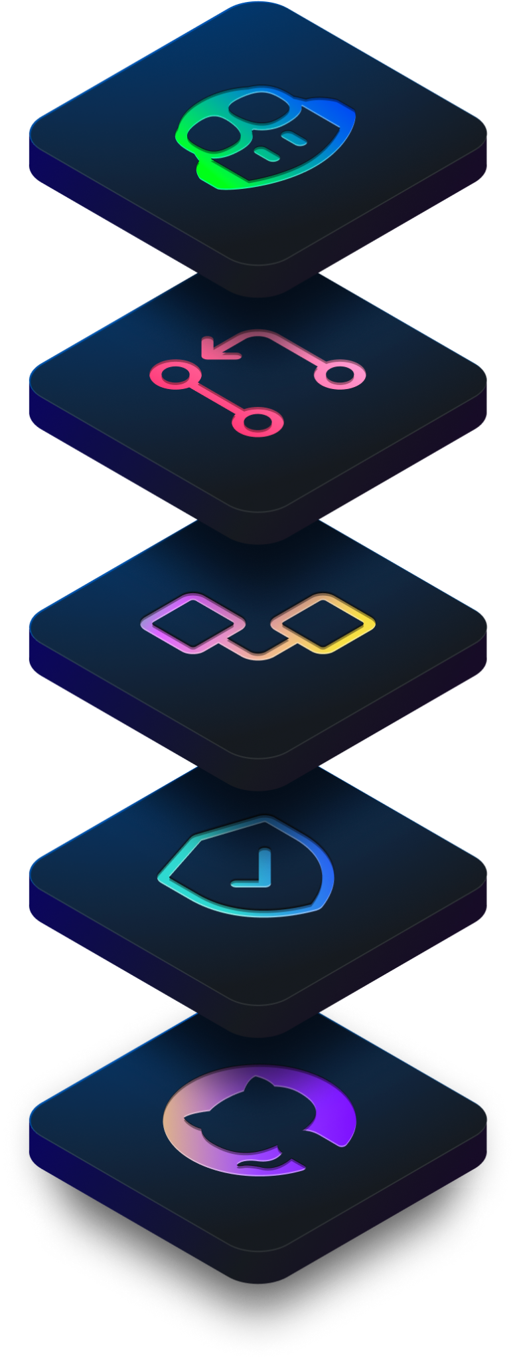

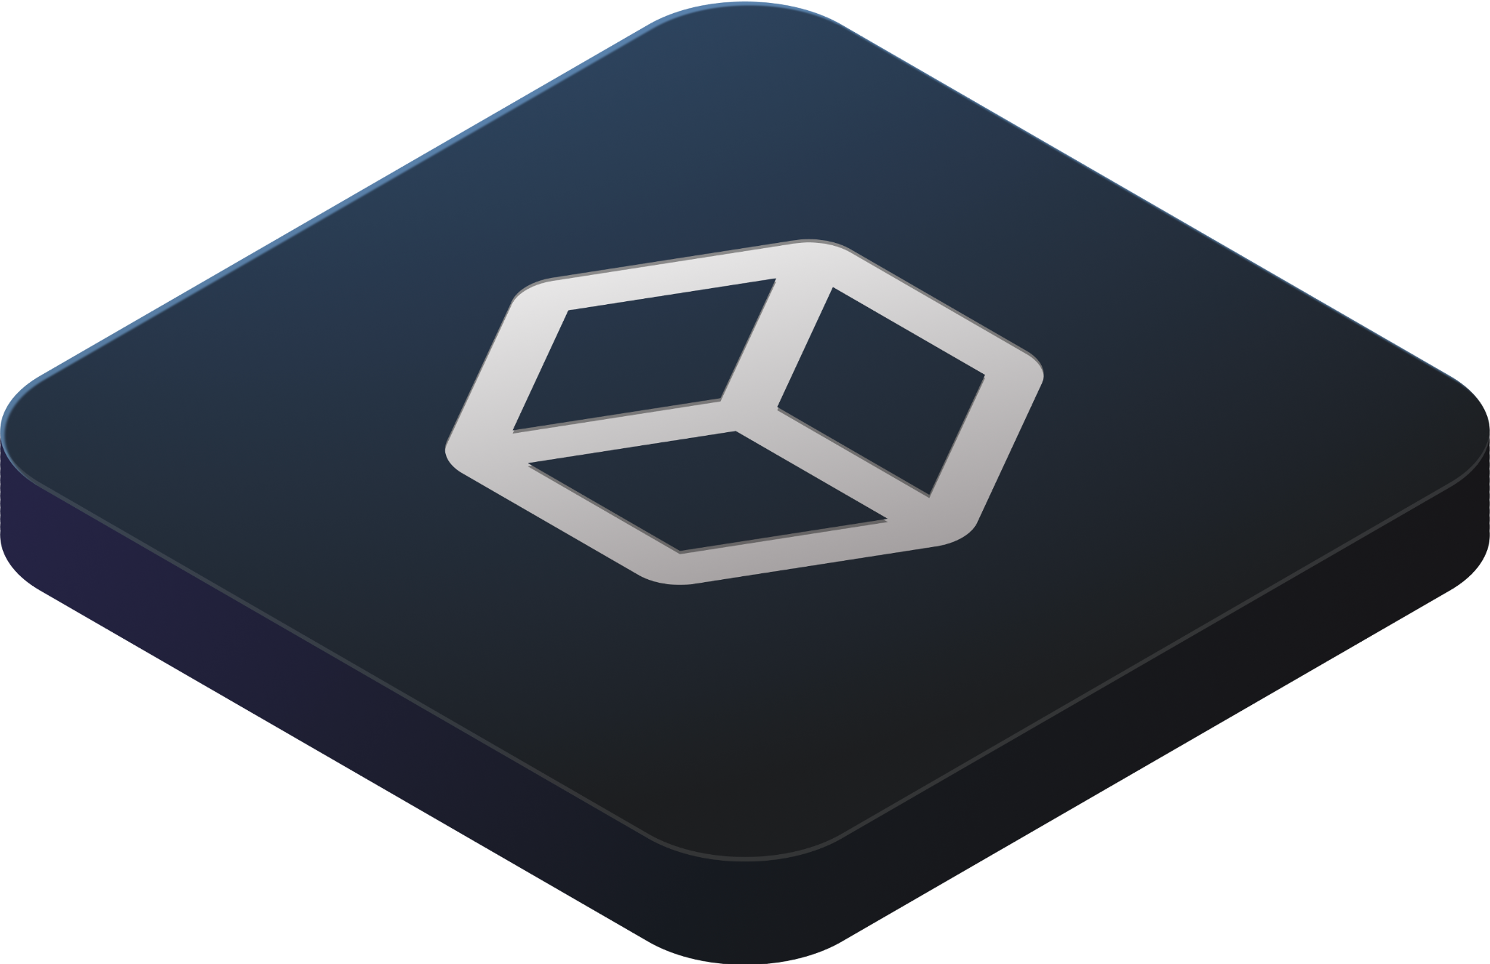


Copilot
Collaboration
Pull requests
Projects
Issues
Discussions
Merge queue
Search
Productivity
CI/CD with Actions
Automation
Copilot
Codespaces
Runners
npm
Mobile
Security
Advanced Security
Secret scanning
Code scanning
Security overview
Supply chain
Dependabot
Scale
Integrations & APIs
100M+ developers
Source code management
Notes:
Let’s take a look at how it all comes together in GitHub Platform: the AI-powered developer platform, globally available, secure by default.
GitHub Platform focuses on the developer experience–it has the scale to provide industry-changing insights, collaboration capabilities for transformative efficiency, the tools for increased productivity, security at every step, and AI to power it all to new heights in a single, integrated platform.
GitHub has the unique opportunity to do all of the above, allowing you to do more through a single integrated developer experience platform.
VALUE PROP HERE: GitHub Enterprise, the one single developer experience. Powered by AI and secure at every step. Helping your teams be more productive, collaborative, and efficient.
GitHub has the unique opportunity to do all of the above, plus transform your business through a single developer experience platform. When speaking with thought leaders, executives, and the C-suite, companies care about the production side of their business to ship faster and more securely.
But GitHub has the unique advantage to additionally transform businesses through a cultural shift. GitHub is loved by developers, and is built on the data of 100+ million developers. With all this data, we have the unique opportunity to understand what the best developer experience is, while upholding our strong brand for all developers who use GitHub for the first time in school, as a hobby, or even to just learn.
How does it all fit together? GitHub Enterprise contains 3 core pillars where we are continuing to make investments: collaboration, automation, security, and powered by AI that runs through the platform. With AI coming to all areas of GitHub, you will be able to use all the best features of GitHub, but with even greater simplicity. (this sentence also might need work…)

Slide 32
Examples
Teams As Code
Issue Ops
Chat Ops

Slide 33
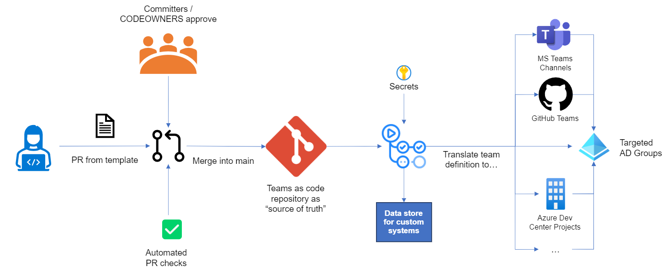
Teams As Code

Slide 34
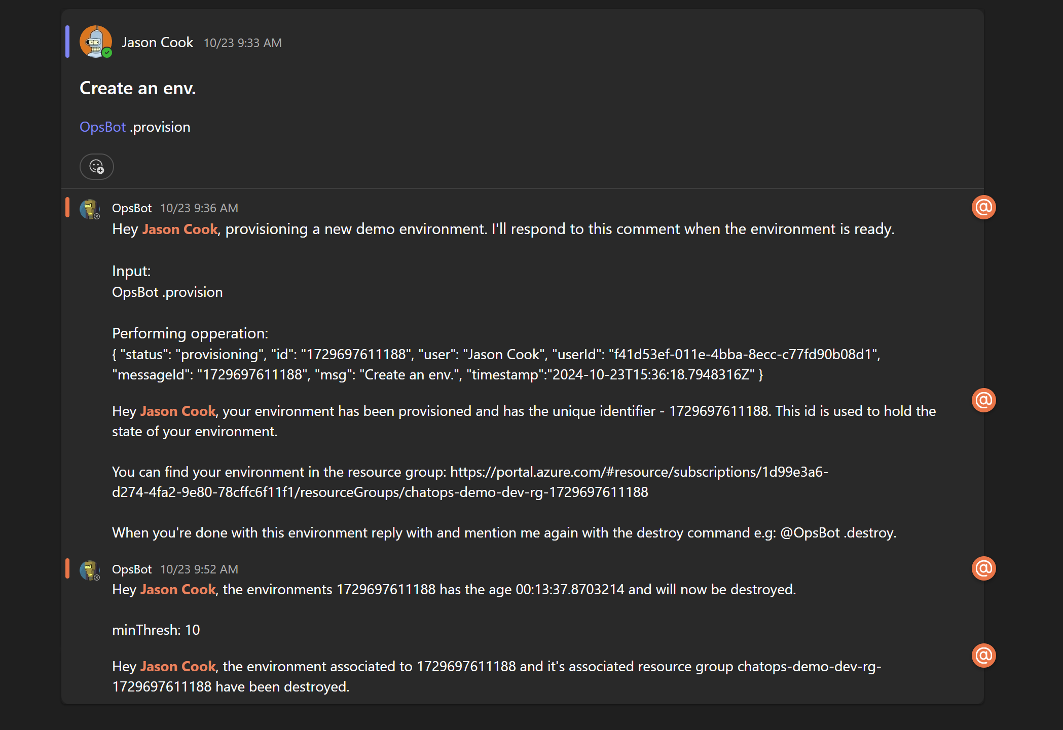
ChatOps

Slide 35
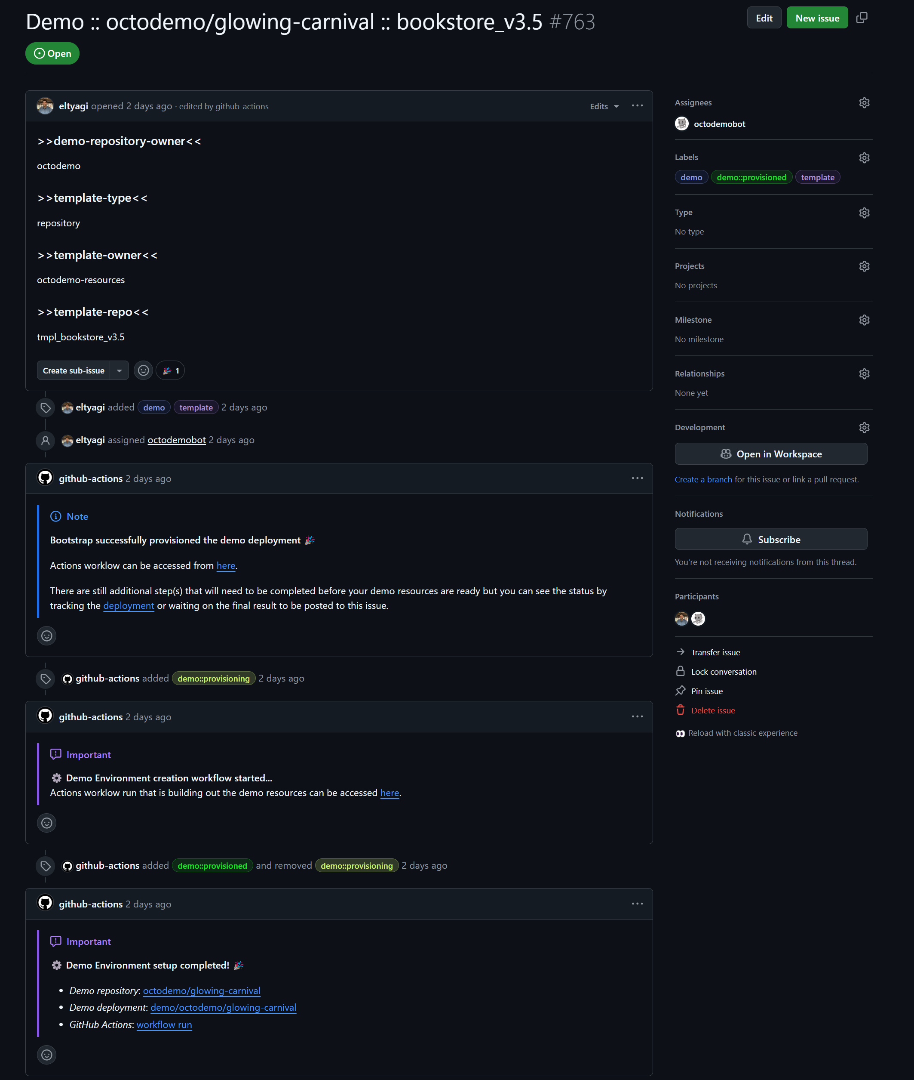
IssueOps

